Slide 1
DITA Topics - Advanced

Slide 2
Session Results
Topic Types Review
Format/Layout Separated from Content
DITA Concept Elements
Using DITA Concept Elements - Advanced
Common DITA Task Elements
Using DITA Task Elements - Advanced
Additional DITA Task Elements
Common DITA Reference Elements
Using DITA Task Elements - Advanced

Slide 3
DITA topic information
Reference for this session
DITA Best Practices
A Roadmap for Writing, Editing, and Architecting in DITA
Laura Bellamy, Michelle Carey, and Jenifer Schlotfeldt
Copyright 2012

Slide 4
Topic types review
Concept
Describes something.
Task
Tells how to do something. Usually includes numbered steps.
Reference
Gives details of interest, often in look-up lists or tables.

Slide 5
Format/layout are separated from content
Authoring environment allows you to create content
Authoring environment allows you to tag your content according to the DITA standard (consistent flow of content depending on topic type)
Authoring environment DOES NOT CONTROL the final layout of your content (publishing engine does this)
Benefits to this
Focus on creating quality content
Do not focus on layout and formatting
Build and publish content in many ways to many outputs (You become proactive and not reactive to customer needs.)

Slide 6
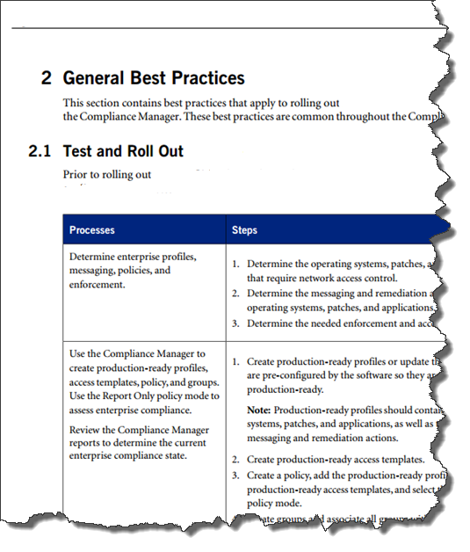
Same content – different output

Slide 7
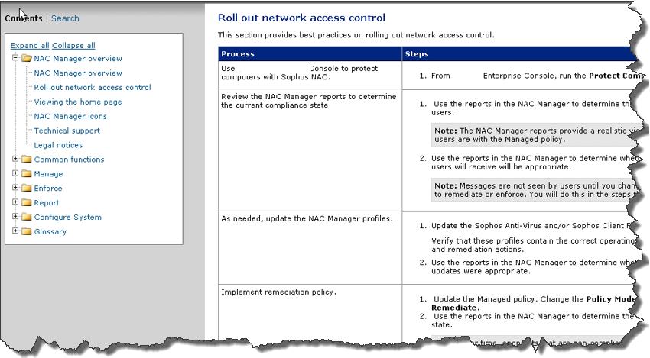
Same content – different output

Slide 8
Common DITA concept elements
DITA Element | Description
<title> | Provides the topic title
<shortdesc> | Introduces the concept
<conbody> | Contains the body of the topic
<section> | Organizes content in a topic into sections
<sl> | Displays a list of short or simple items
<ul> | Displays a content as an unordered bulleted list
<dl> | Displays a list of terms or short concepts and their definitions
<fig> or <image> | Provides a figure and caption so that you can insert graphics
<term> | Highlights new terms

Slide 9
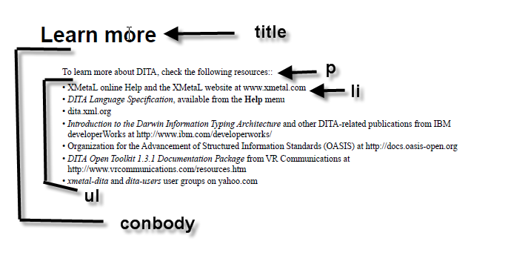
Concept Example
Use of common DITA concept elements

Slide 10
Concepts - let’s put tagging into practice
I am going to show you a concept topic.
You are going to determine what concept tag you are looking at based on the set of most common tags that I have provided.
Answers are in the notes section of the presentation.

Slide 11
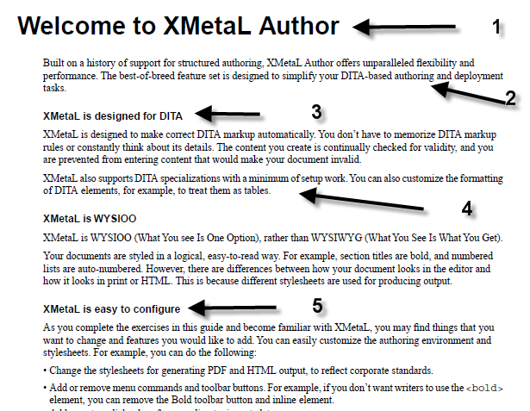
Notes:
Title
Short Description
Section Title
Paragraph
Section Title

Slide 12
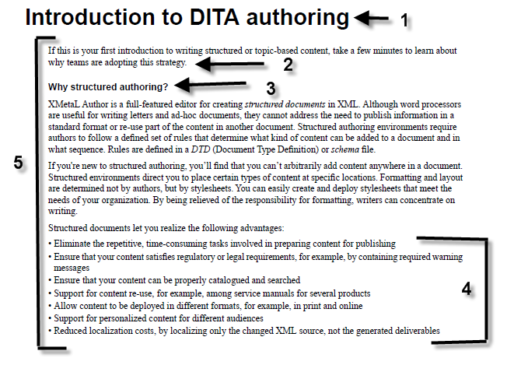
Notes:
Title
Paragraph
Section Title
Un-ordered list

Slide 13
Common DITA task elements
DITA Element | Description
<title> | Provides the topic title
<taskbody> | Body of the task
<shortdesc> | Introduces the task
<steps> | Contains ordered steps for the entire procedure
<steps-unordered> | Contains unordered steps for the entire procedure
<context> | Background information for users to understand task
<steps>,<step>, and <cmd> | Contains the steps for the task
<substeps>, <substep>, and <cmd> | Contains the substep for the step
<info> | Provides information users need to complete the step
<note> | Note information (most often nested in the <info> tag)
<stepresult> | What happens when step is completed
<stepxmp> | An example of what happens when step is completed
<choices> and <choice> | Displays choices in a bulleted list
<choicetable> | Displays choices in a 2-column table. Describe steps for choice
<postreq> | Info about what must be done after task is completed
<example> | Example that tells or supports the task
<result> | Expected outcome when task is done

Slide 14
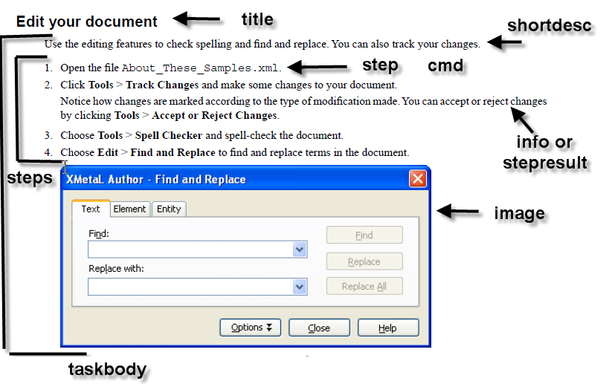
Use of common DITA task elements

Slide 15
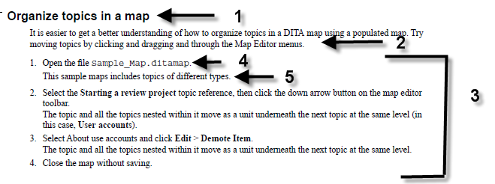
Notes:
Title
Short Description
Steps
Step with Command
Step Result

Slide 16
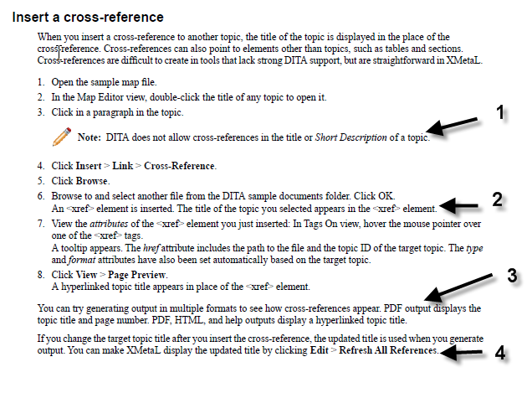
Task Topic
Notes:
Note
Step with Command
Example
Result

Slide 17
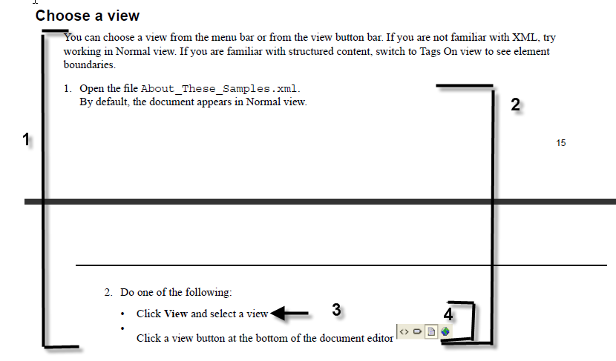
Task Topic
Notes:
Task
Task body
Choice
Choices

Slide 18
Other common task tags
DITA Attribute | Description
<uicontrol> | Put this tag around items that are menu driven from the UI
<menucascade> | Put this tag around a menu sequence that a user selects (File > Open)
<cmdname> | Put this tag around UI commands, usually button names.
<filepath> | Put this around any file path that points to a specific location
<varname> | Used for variables that may change depending on circumstances
<userinput> | Put this tag around text that a user types verbatim
<codeblock> | Put this tag around a block of code

Slide 19
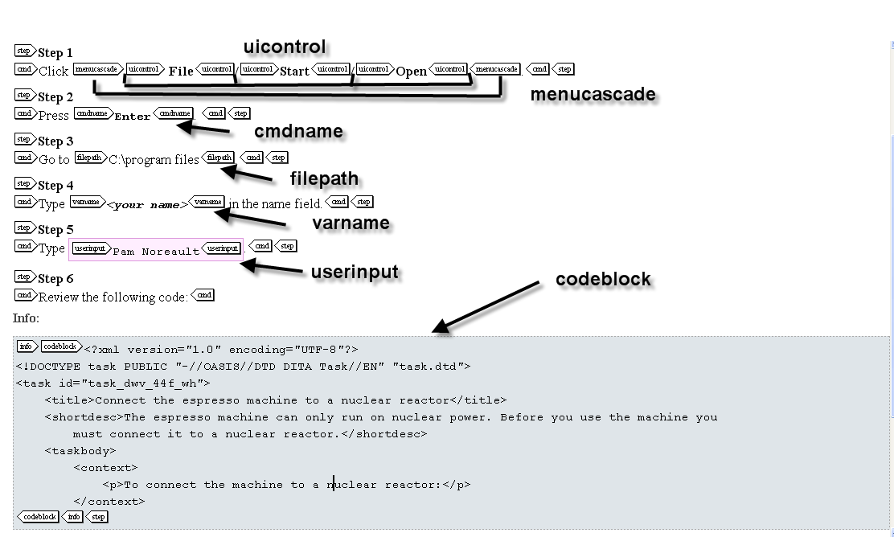
Common Task Tags - Usage
Use of other common task tags

Slide 20
Common DITA reference elements
DITA Element | Description
<title> | Provides the topic title
<shortdesc> | Introduces the reference
<refbody> | Contains the body of the topic
<section> | Organizes content in a topic into sections
<table> | Contains table content
<ul> | Displays a content as an unordered bulleted list
<dl> | Displays a list of terms or phrases and their definitions
<example> | Contains example content that explains or supports the topics
<parml> | Displays parameters in a format similar to a definition list
<properties> | Lists properties in a table by type, value, and description
<simpletable> | Provides a table that doesn’t require a title
<refsyn> | Contains a syntax diagram

Slide 21
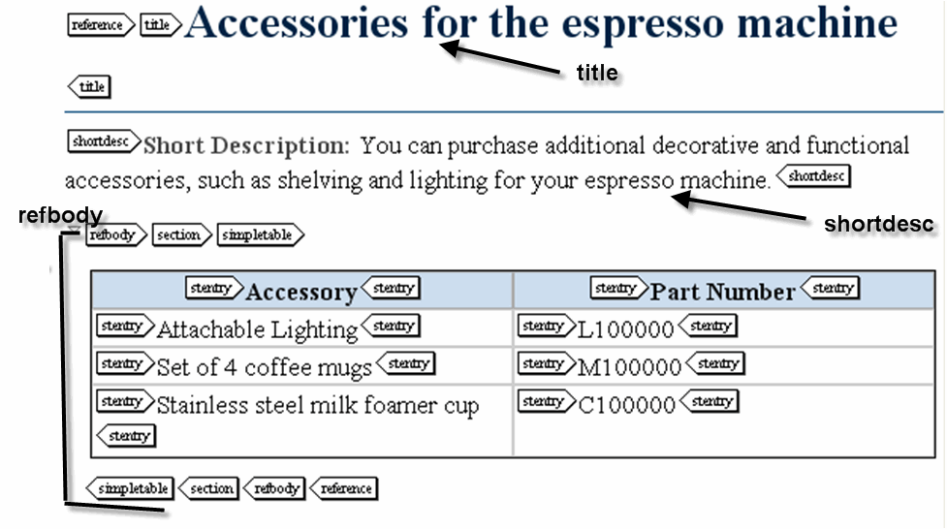
Reference Sample
Use of common DITA reference elements

Slide 22
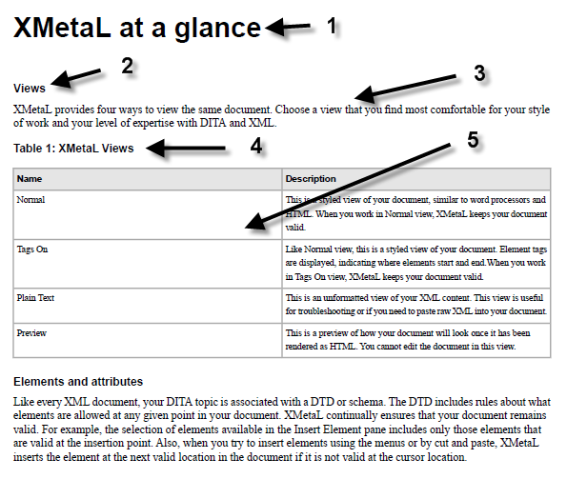
Reference sample – answers in notes
Notes:
Title
Section title
Paragraph
Section title
Paragraph

Slide 23
DITA tips and tricks to selecting elements
Use the authoring tool and what it provides to you (help, tooltips, DITA standard enforcement)
Keep the content simple (If you can’t figure out how to use the elements, you probably should be selecting a different way to write your content. Just because you can do it, does not mean you should do it.)
Look at other DITA documents for guidance
Use the DITA 1.2 standard which provides definitions for you

Slide 24
Your JOB to learn more
If you are unfamiliar with DITA elements:
Practice assigning DITA elements to parts of your topics.
Practice assigning the new DITA elements to task topics.

Slide 25
Session Results
Topic Types Review
Format/Layout Separated from Content
DITA Concept Elements
Using DITA Concept Elements - Advanced
Common DITA Task Elements
Using DITA Task Elements - Advanced
Additional DITA Task Elements
Common DITA Reference Elements
Using DITA Task Elements - Advanced
Confidential

